Slide 1
Environmental monitoring in parks
Phase - 5

Slide 2
Overview
Environmental monitoring in parks involves the systematic collection and analysis of data to assess and protect the natural environment within these areas. This process helps park authorities make informed decisions and manage the ecosystem's health. Key aspects of environmental monitoring in parks include tracking air and water quality, biodiversity assessments, climate monitoring, and the impact of human activities on these ecosystems. It plays a crucial role in ensuring the preservation and sustainability of parks and their ecosystems.

Slide 3
Objective
Assessing and preserving biodiversity: Monitoring the diversity of plant and animal species to ensure their conservation and prevent the introduction of invasive species.
Protecting water quality: Monitoring the quality of water bodies within the park to safeguard aquatic ecosystems and ensure safe recreational use.
Air quality management: Monitoring air pollutants and addressing issues that may impact the health of park visitors and ecosystems.

Slide 4
Soil and habitat preservation: Assessing soil quality and habitat conditions to protect the natural landscape and promote ecological balance.
Climate change and weather monitoring: Tracking climate-related changes to plan for adaptation strategies and mitigate impacts.
Visitor impact assessment: Monitoring the impact of human activities on the park's natural resources and implementing strategies to minimize negative effects.
Natural resource management: Managing resources sustainably, such as timber, wildlife, and fisheries, while preserving the park's integrity.

Slide 5
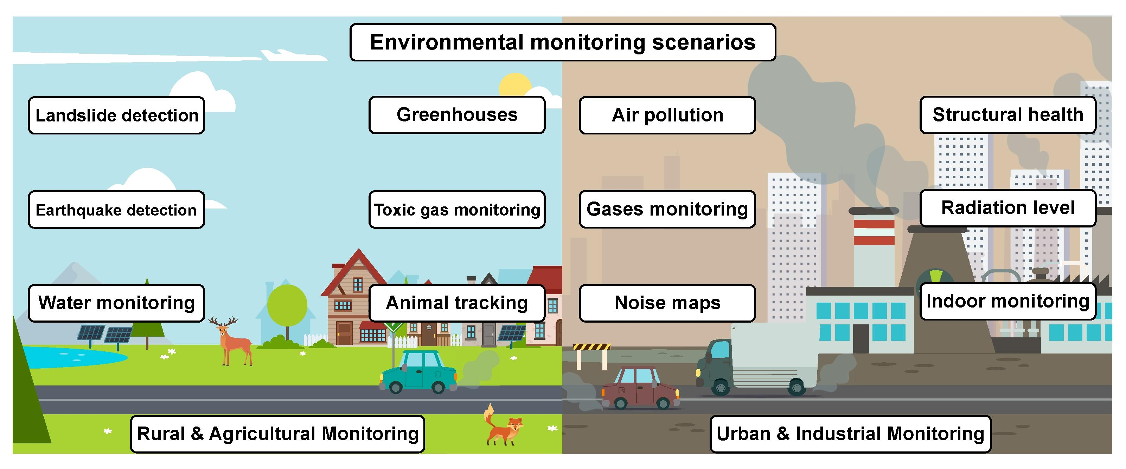
Environmental monitoring:-

Slide 6
IOT device development
Here are some of the key steps involved in deploying environmental monitoring IoT devices:
1. Identify the environmental conditions you want to monitor. This could include air quality, water quality, weather conditions, noise levels, or radiation levels.
2. Select the appropriate IoT devices. There is a wide range of IoT devices available, so it is important to choose devices that are designed to measure the specific environmental conditions you are interested in.
3.Install the IoT devices in the appropriate locations.* This may involve installing the devices on poles, buildings, or other structures.

Slide 7
4."Configure the IoT devices to collect data at the desired frequency.This will depend on the specific environmental conditions you are monitoring.
5.Connect the IoT devices to a cloud platform.This will allow you to access and analyze the data remotely.
6.Develop and implement data analytics and visualization tools. This will allow you to identify trends and patterns in the data, and to generate reports and alerts.
Once the IoT devices are deployed and configured, you can begin collecting data about the environment. This data can be used to track trends, identify problems, and make informed decisions about how to protect the environment.

Slide 8
Here are some specific examples of how environmental monitoring IoT devices are being used today:
Air quality monitoring: IoT devices can be used to monitor air quality levels in urban areas, industrial settings, and other locations. This data can be used to identify sources of air pollution and to develop strategies for improving air quality.
Water quality monitoring: IoT devices can be used to monitor water quality levels in rivers, lakes, and other bodies of water. This data can be used to identify sources of water pollution and to develop strategies for protecting water resources.
"Weather monitoring:" IoT devices can be used to monitor weather conditions, such as temperature, humidity, wind speed, and precipitation. This data can be used to forecast weather conditions and to warn people of severe weather events.

Slide 9
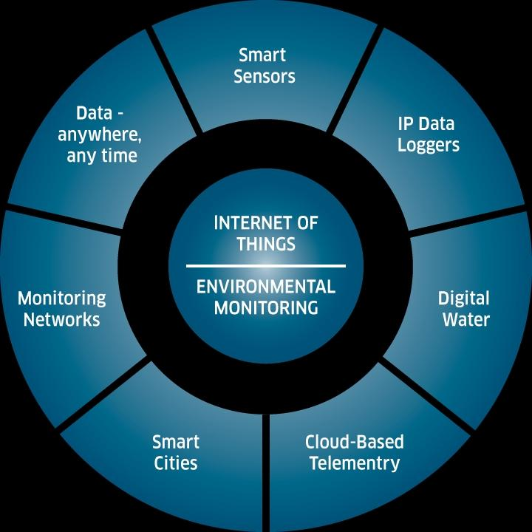
Design:-

Slide 10
Platform development
1. Requirements gathering: The first step is to gather requirements for the platform. This includes identifying the specific environmental conditions that need to be monitored, the frequency at which data needs to be collected, and the types of reports and alerts that need to be generated.
2. System design: Once the requirements have been gathered, the system can be designed. This includes choosing the appropriate hardware and software components, and designing the database schema.
3. Implementation: The next step is to implement the system. This includes developing the software code, configuring the hardware, and populating the database,
4. Testing: Once the system has been implemented, it needs to be tested to ensure that it meets the requirements and that it is working properly.
5. "Deployment: Once the system has been tested and verified, it can be deployed to production.

Slide 11
Here are some of the key features that an environmental monitoring platform should have:
Data collection: The platform should be able to collect data from a variety of environmental monitoring sensors.
Data storage:The platform should be able to store the collected data in a secure and efficient manner.
Data analysis: The platform should be able to analyze the collected data to identify trends and patterns.
Data visualization: The platform should be able to visualize the collected data in a way that is easy to understand,
Alerting:The platform should be able to generate alerts when certain environmental conditions exceed predefined thresholds.
Reporting: The platform should be able to generate reports on environmental conditions, trends, and alerts.

Slide 12


Slide 13


Slide 14
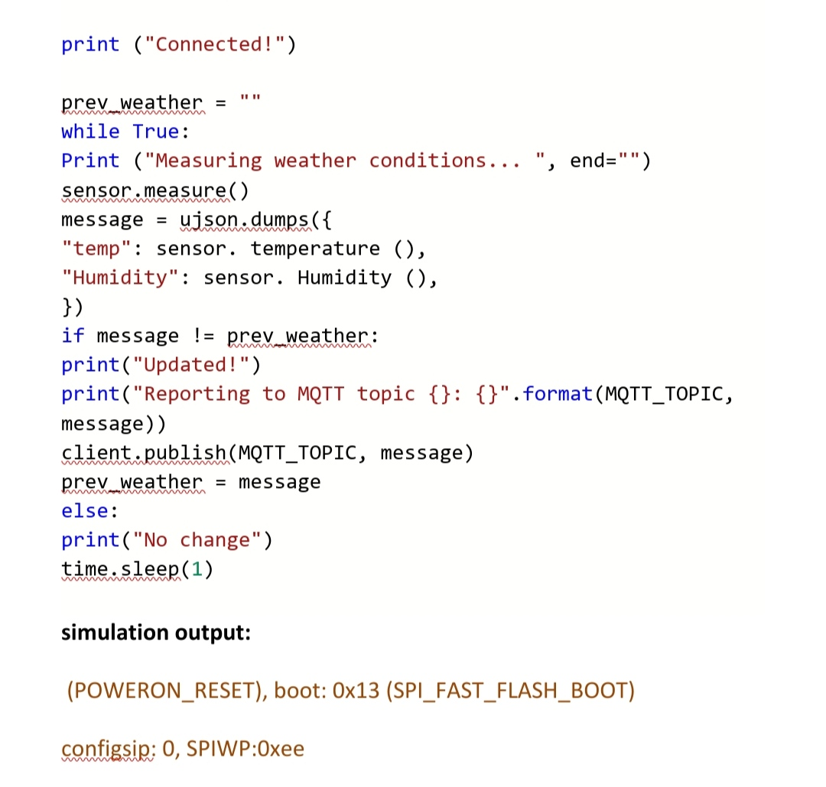

Slide 15
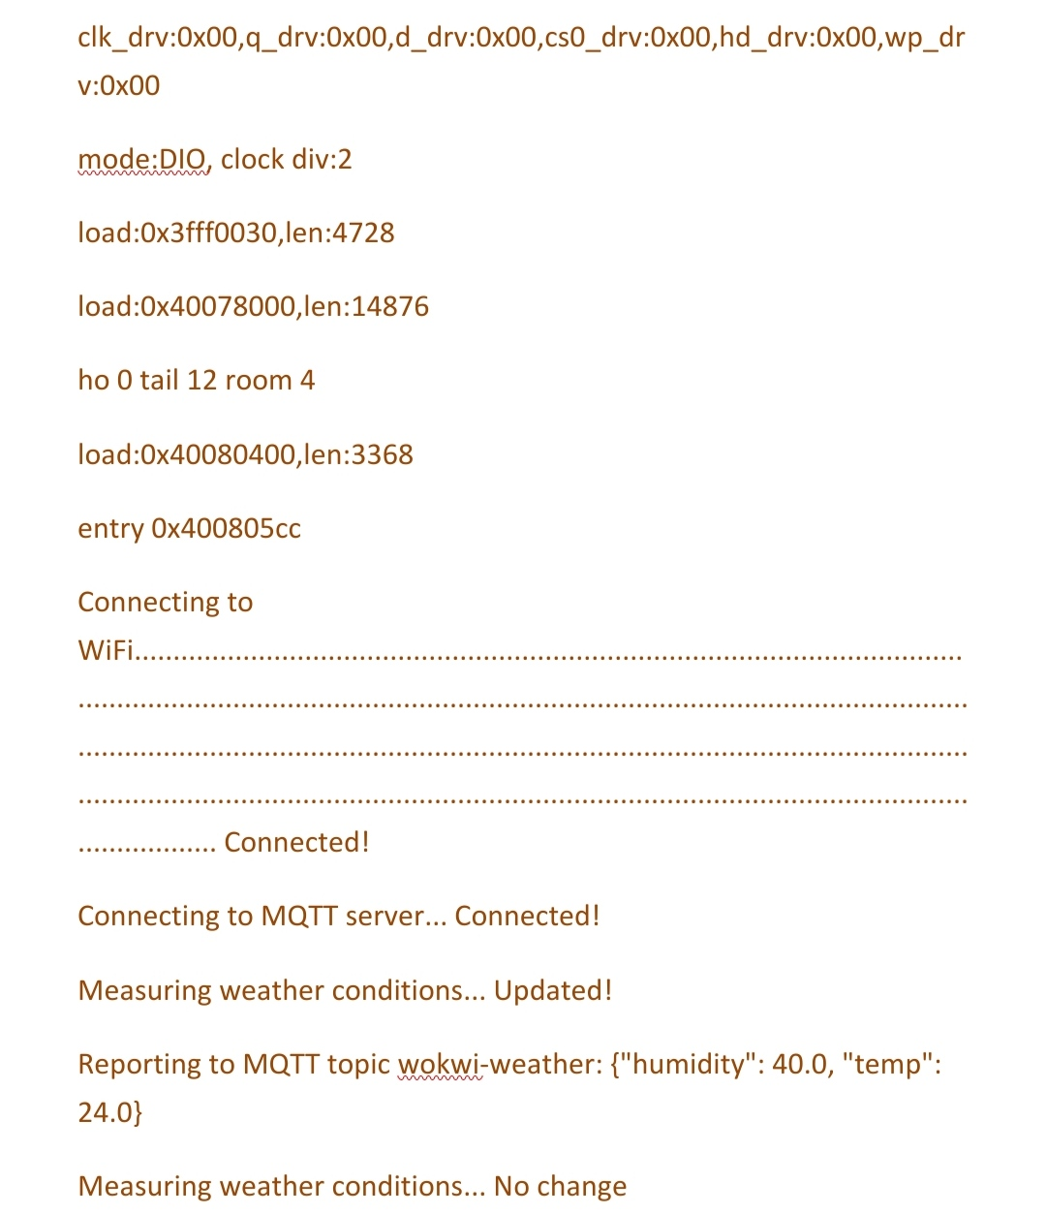

Slide 16
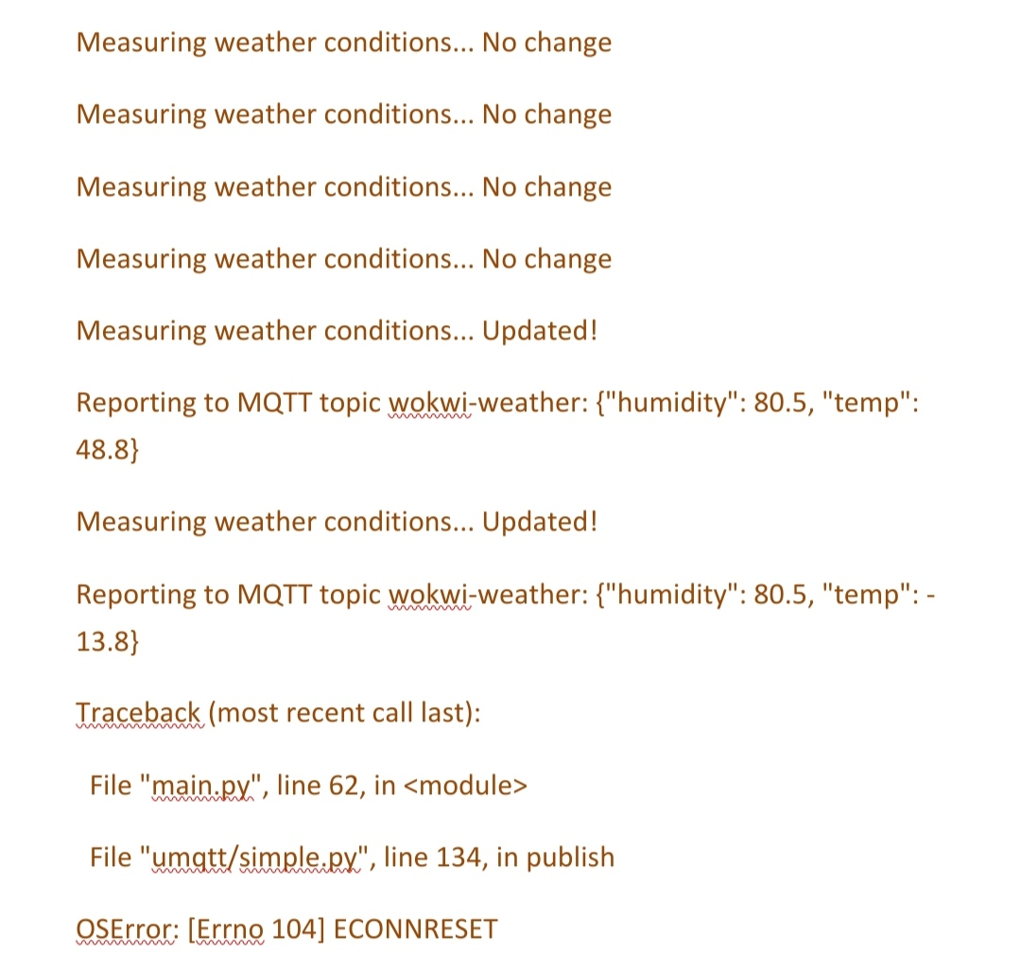

Slide 17
how the real-time environmental monitoring system benefits park visitors
Safety: RTEMS can track and monitor environmental conditions that could pose a safety hazard to visitors, such as air quality, water quality, and extreme weather events. This information can be used to warn visitors of potential dangers and to help park managers take steps to mitigate risks. For example, if an RTEMS detects that air quality levels have reached unhealthy levels, park managers could issue alerts to visitors and close certain areas if necessary.
Health: RTEMS can also track and monitor environmental conditions that could impact visitors' health, such as pollen levels, UV radiation, and heat index. This information can help visitors take steps to protect themselves from harmful environmental exposures, For example, a visitor with allergies could check the pollen forecast before heading out for a hike.

Slide 18
Comfort: RTEMS can also track and monitor environmental conditions that could affect visitors' comfort, such as temperature, humidity, and wind speed. This information can help visitors plan their activities and dress appropriately. For example, a visitor could check the temperature forecast before going for a run.
Enjoyment: RTEMS can provide visitors with real-time information about the natural environment, such as wildlife locations, plant blooming times, and trail conditions. This information can help visitors plan their activities and get the most out of their time in the park, For example, a visitor could check the wildlife location map to see if there are any bears in the area before going for a hike.

Slide 19
how the real-time environmental monitoring system promotes outdoor activities.
Making outdoor activities more accessible: RTEMS can make outdoor activities more accessible to people with certain health conditions or disabilities. For example, a person with asthma could use the air quality map to find areas of the park where the air quality is good.
Encouraging people to spend more time outdoors: By making outdoor activities more comfortable, safe, and enjoyable, RTEMS can encourage people to spend more time outdoors. This can have a number of benefits, including improved physical and mental health, reduced stress levels, and increased. appreciation for nature.

Slide 20
Promoting environmental stewardship: RTEMS can also help to promote environmental stewardship by educating visitors about the natural environment and the potential impacts of human activity. For example, a visitor could use the RTEMS to learn about the different species of plants and animals that live in the park and the ways in which they can help to protect these species.
Overall, RTEMS can play an important role in both benefiting park visitors and promoting outdoor activities. By providing real-time information about environmental conditions, RTEMS can help visitors stay safe, healthy, comfortable, and informed. This can make outdoor activities more accessible and enjoyable for people of all ages and abilities, and it can also help to promote environmental stewardship.

Slide 21

Conclusion
In conclusion, an Environmental Monitoring System using the Internet of Things (IoT) represents a transformative and highly valuable technology for addressing a wide range of environmental challenges. This system harnesses the power of interconnected sensors, devices, and data analytics to collect, manage, and analyze environmental data in real-time.

